Slide 1
Trust Aware Recommendation Systems

Slide 2
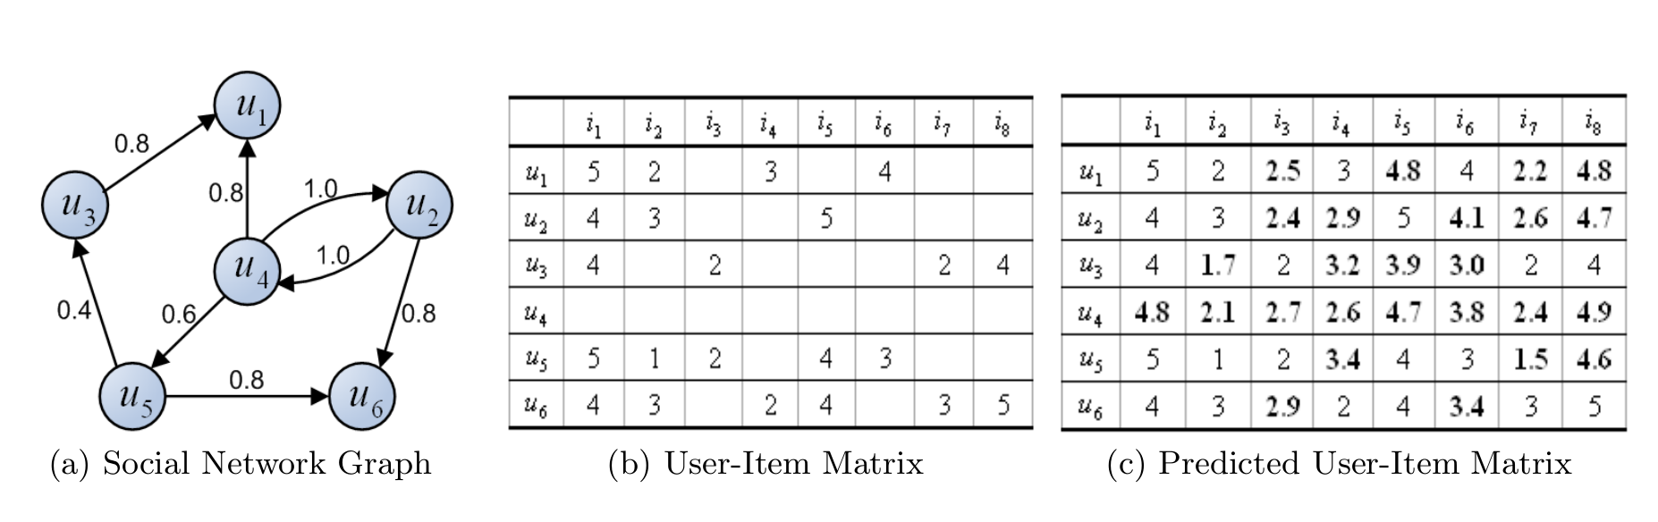
Problem

Slide 3
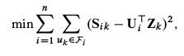
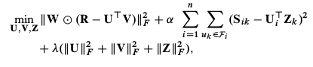
Sorec

Slide 4
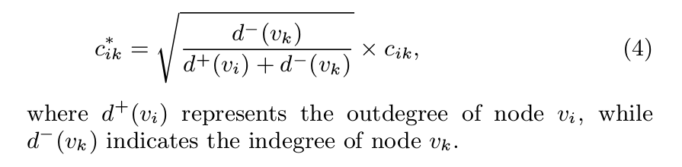
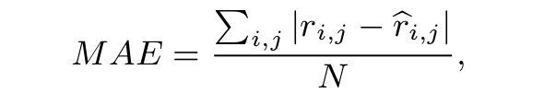
Testing
80% Train, 20% Test
With weight : MAE: 0.93
Without weight: MAE: 0.87

Slide 5

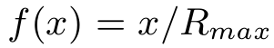
Testing
80% Train, 20% Test
: 0.87
: 0.83

Slide 6
Time and Efficiency
User/Items | Time: Initially
7000/21000 | 10-12 Hours
Time: After
20 Sec

Slide 7
Time and Efficiency
Users/Items | Run Time | Mean Absolute Error | MAE in paper | Training Data
49290/139738 | 29 min | 0.82 | 0.90 | 99%
49290/139738 | 26 min | 0.83 | 0.932 | 80%
7000/21000 | 20 sec | 0.93 | 0.932 | 80%
3000/9000 | 5 sec | 0.90 | 0.932 | 80%
7000/21000 | 20 sec | 0.88 | 0.90 | 99%
3000/9000 | 4 sec | 0.87 | 0.90 | 99%

Slide 8
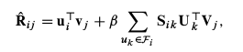
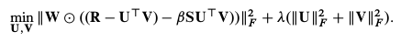
STE

Slide 9
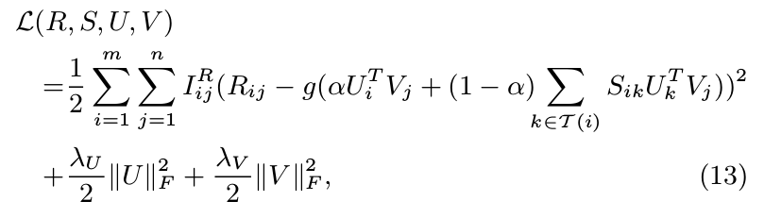
STE

Slide 10
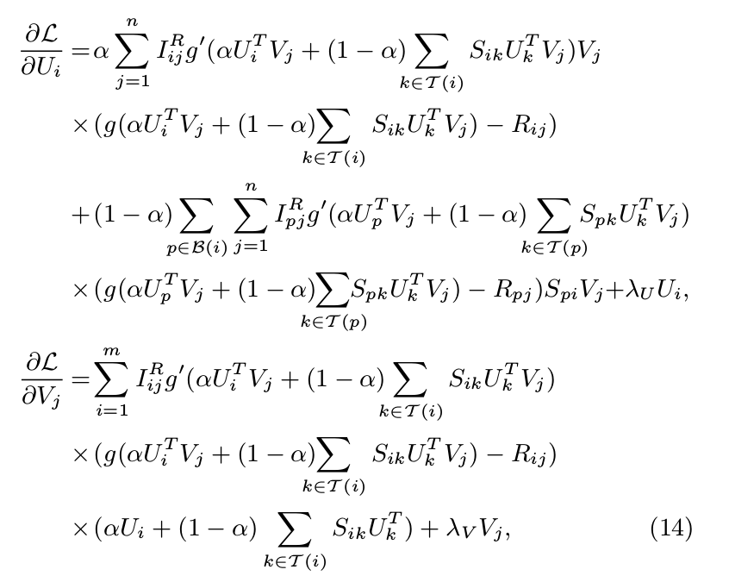
STE

Slide 11
STE
Users/Items | Run Time | Mean Absolute Error | MAE in paper | Training Data
7000/21000 | 19m | 0.93 | 0.859 | 80%
3000/9000 | 10m | 0.93 | 0.859 | 80%
7000/21000 | 18m | 0.90 | 0.837 | 90%
3000/9000 | 11 m | 0.89 | 0.837 | 90%

Slide 12

Thanks!
Student Info:
P. Rishith Reddy
201401159
rishith.reddy@students.iiit.ac.in

